Slide 1
Chapter13: Digital Signatures
Freshman Seminar
2022.02.08
Sumin Sohn

Slide 2
Contents
13.1 Digital Signature
13.2 Elgamal Digital Signature Scheme
13.4 NIST Digital Signature Algorithm
13.5 Elliptic Curve Digital Signature Algorithm

Slide 3
13.1 Digital Signature

Slide 4
Properties of Digital Signature
Need for digital signature
Message authentication protects 2 parties who exchange messages from any third party but it does not protect the 2 parties against each other
Example
Mary may forge a different message and claim that it came from John
John can deny sending the message
Properties of digital signature
It must verify the author and the date and time of the signature
It must authenticate the contents at the time of the signature
It must be verifiable by third parties, to resolve disputes

Slide 5
Attacks
Key-only attack
C only knows A’s public key
Known message attack
C is given access to set of messages and their signatures

Slide 6
Chosen Message Attacks
Generic chosen message attack
C chooses a list of messages before attempting to breaks A’s signature scheme, independent of A’s public key
Directed chosen message attack
List of messages to be signed is chosen after C knows A’s public key but before any signatures are seen
Adaptive chosen message attack
C is allowed to use A as an oracle
C may request from A signatures of messages that depend on previously obtained message-signature pairs

Slide 7
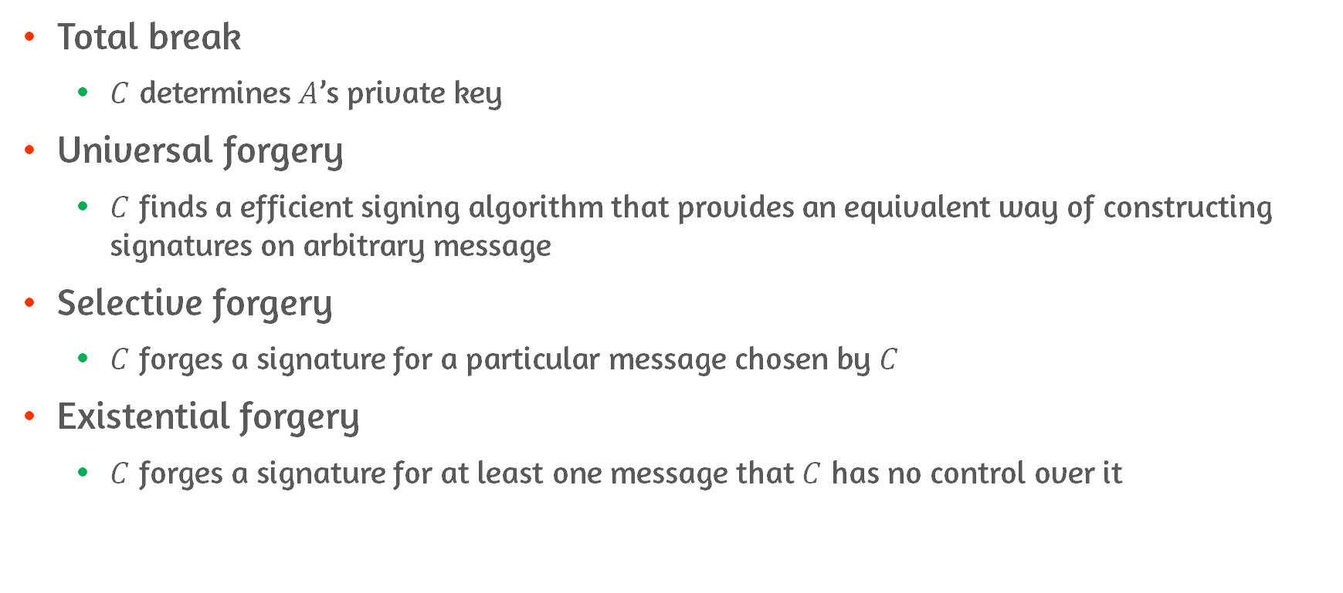
Forgeries
Total break
$C$ determines $A$’s private key
Universal forgery
$C$ finds a efficient signing algorithm that provides an equivalent way of constructing signatures on arbitrary message
Selective forgery
$C$ forges a signature for a particular message chosen by $C$
Existential forgery
$C$ forges a signature for at least one message that $C$ has no control over it

Slide 8
Digital Signature Requirements
Signature must be a bit pattern that depends on the message being signed
Signature must use some information unique to the sender
It must be relatively easy to produce the digital signature
It must be relatively easy to recognize and verify the signature
It must be computationally infeasible to forge a digital signature
Infeasible to construct a new message for an existing digital signature
Infeasible to construct a fraudulent digital signature for a given message
It must be practical to retain a copy of the digital signature in storage

Slide 9
Direct Digital Signature
Definition
Digital signature scheme that involves only communicating parties(source, destination)
Scheme
Encrypting entire message plus signature with a shared secret key
Important to perform signature function first then an outer confidentiality function
If signature if performed on an encrypted message, the third party also needs to access the shared secret key in case of dispute
Validity
Validity of the scheme depends on the security of the sender’s private key
Administrative controls related to security of private keys may be employed
Case of private key stolen or forgery
Timestamp could also be included for revocation of compromised keys

Slide 10
13.2 Elgamal Digital Signature Scheme

Slide 11
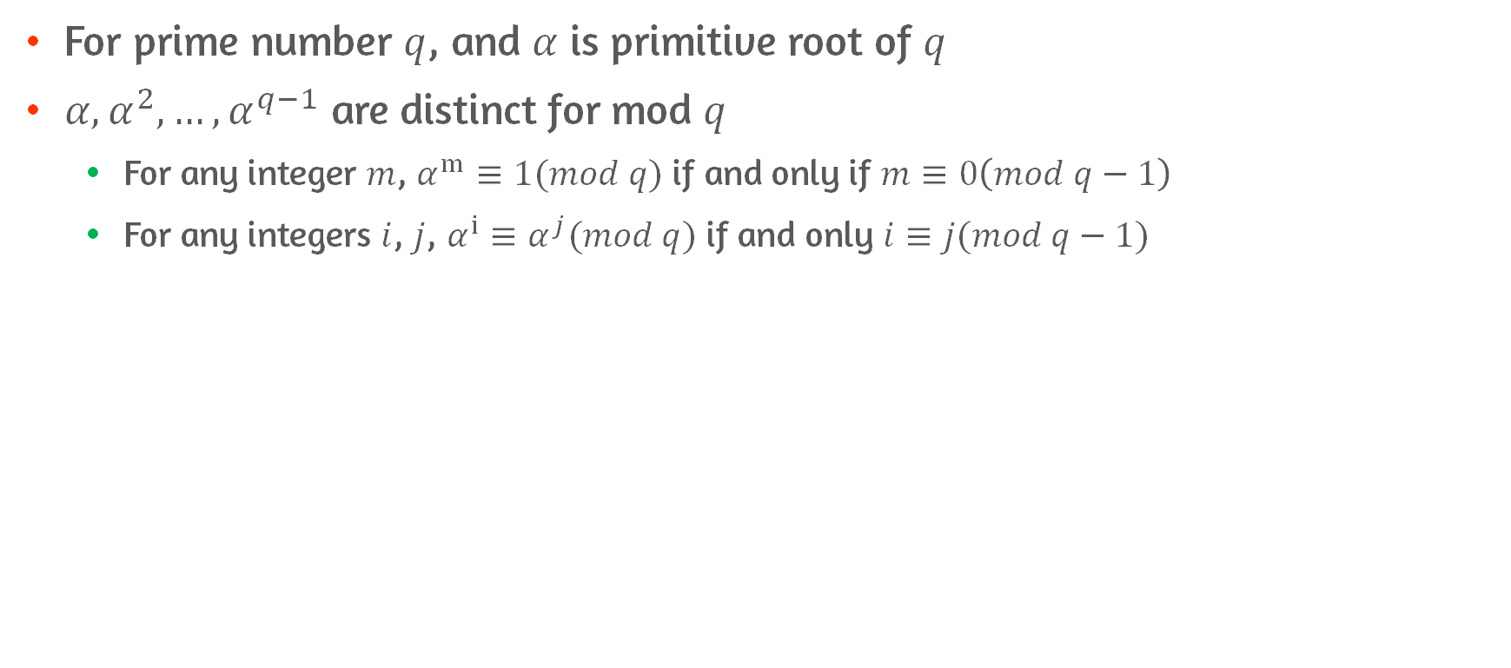
Number Theory
For prime number $q$, and $α$ is primitive root of $q$
$α,α^{2}, …,α^{q−1}$ are distinct for mod $q$
For any integer $m$, $α^{m}≡1(mod q)$ if and only if $m≡0\left(mod q−1\right)$
For any integers $i$, $j$, $α^{i}≡α^{j}(mod q)$ if and only $i≡j(mod q−1)$

Slide 12
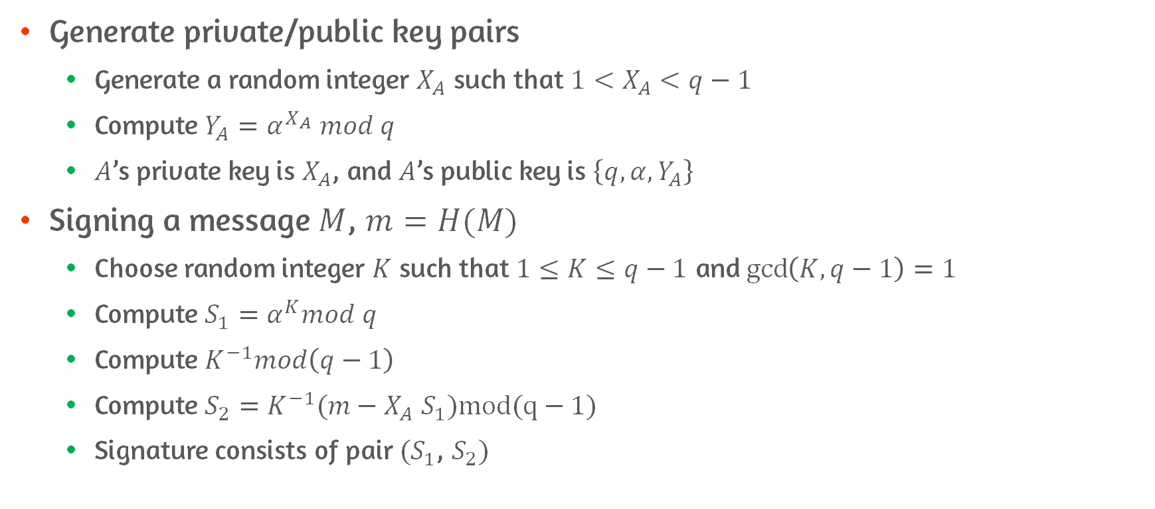
Elgamal Digital Signature #1
Generate private/public key pairs
Generate a random integer $X_{A}$ such that $1<X_{A}<q−1$
Compute $Y_{A}=α^{X_{A}} mod q$
$A$’s private key is $X_{A}$, and $A$’s public key is $\left\{q, α,Y_{A}\right\}$
Signing a message $M$, $m=H(M)$
Choose random integer $K$ such that $1≤K≤q−1$ and $\gcd\left(K, q−1\right)=1$
Compute $S_{1}=α^{K}mod q$
Compute $K^{−1}mod\left(q−1\right)$
Compute $S_{2}=K^{−1}(m−X_{A}$ $S_{1})mod(q−1)$
Signature consists of pair $(S_{1}$, $S_{2})$

Slide 13
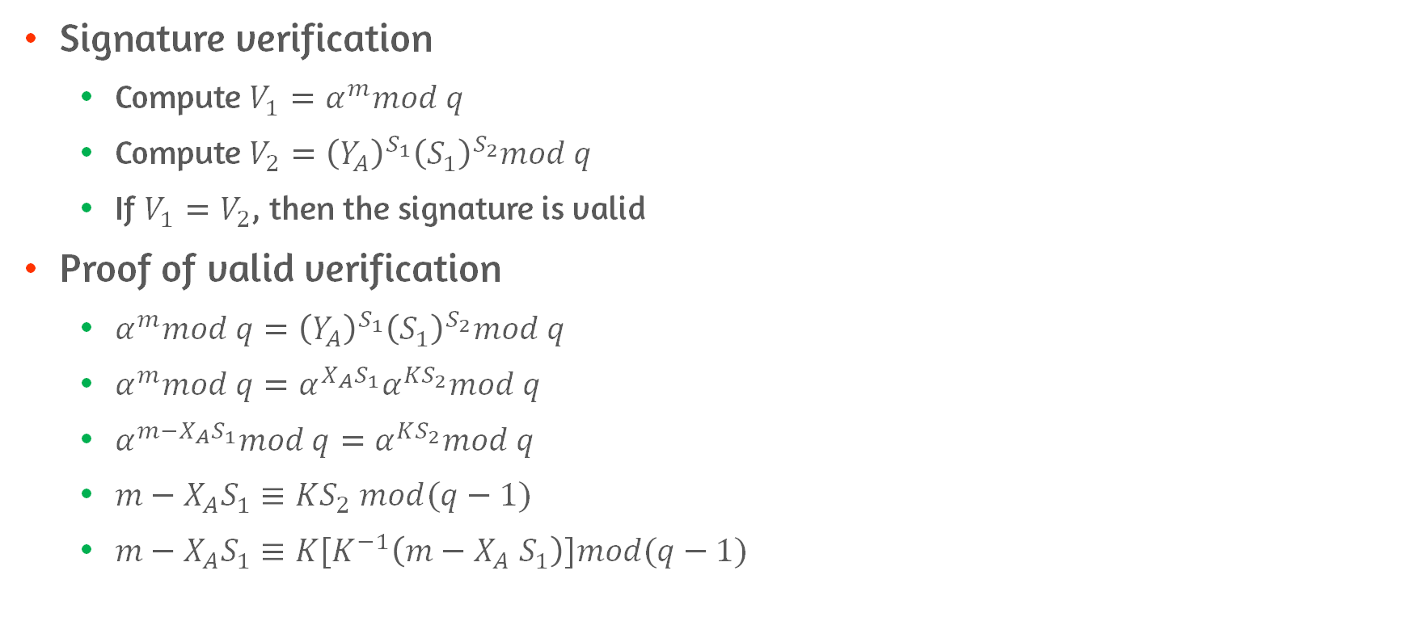
Elgamal Digital Signature #2
Signature verification
Compute $V_{1}=α^{m}mod q$
Compute $V_{2}={\left(Y_{A}\right)}^{S_{1}}{\left(S_{1}\right)}^{S_{2}}mod q$
If $V_{1}=V_{2}$, then the signature is valid
Proof of valid verification
$α^{m}mod q={\left(Y_{A}\right)}^{S_{1}}{\left(S_{1}\right)}^{S_{2}}mod q$
$α^{m}mod q=α^{X_{A}S_{1}}α^{KS_{2}}mod q$
$α^{m−X_{A}S_{1}}mod q=α^{KS_{2}}mod q$
$m−X_{A}S_{1}≡KS_{2} mod(q−1)$
$m−X_{A}S_{1}≡K[K^{−1}\left(m−X_{A} S_{1}\right)]mod(q−1)$

Slide 14
13.4 NIST Digital Signature Algorithm(DSA)

Slide 15
DSA Approach
Uses public-key technique
Uses an algorithm that is designed to provide only digital signature function
It cannot be used for encryption or key exchange

Slide 16
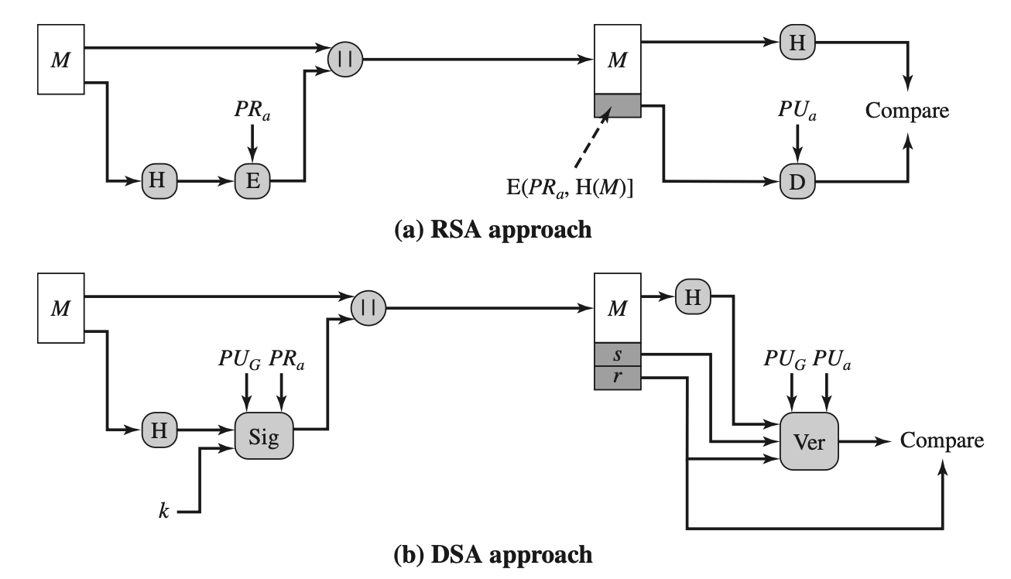
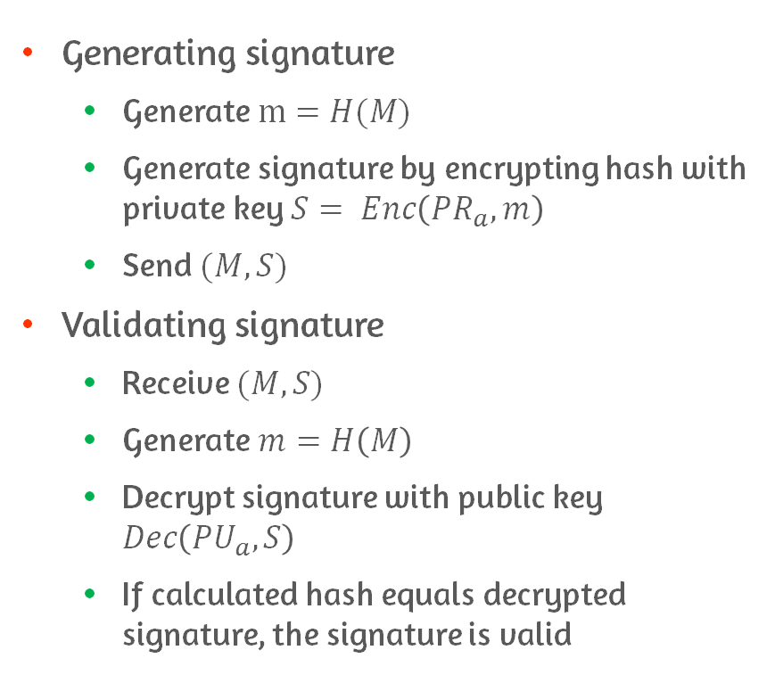
RSA vs. DSA - RSA
Generating signature
Generate $m=H(M)$
Generate signature by encrypting hash with private key $S= Enc\left({PR}_{a},m\right)$
Send $(M,S)$
Validating signature
Receive $(M,S)$
Generate $m=H\left(M\right)$
Decrypt signature with public key $Dec\left({PU}_{a},S\right)$
If calculated hash equals decrypted signature, the signature is valid

Slide 17
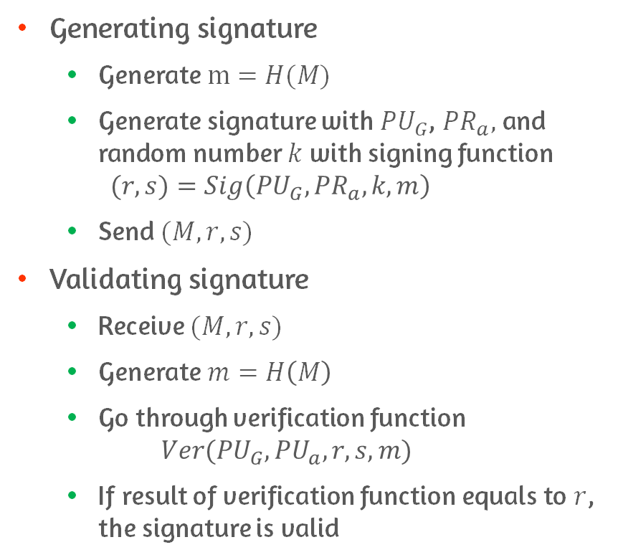
RSA vs. DSA - DSA
Generating signature
Generate $m=H(M)$
Generate signature with ${PU}_{G}$, ${PR}_{a},$ and random number $k$ with signing function $(r, s)=Sig\left({PU}_{G},{PR}_{a}, k, m\right)$
Send $(M,r,s)$
Validating signature
Receive $(M,r,s)$
Generate $m=H\left(M\right)$
Go through verification function $Ver({PU}_{G},{PU}_{a}, r,s,m)$
If result of verification function equals to $r$, the signature is valid

Slide 18
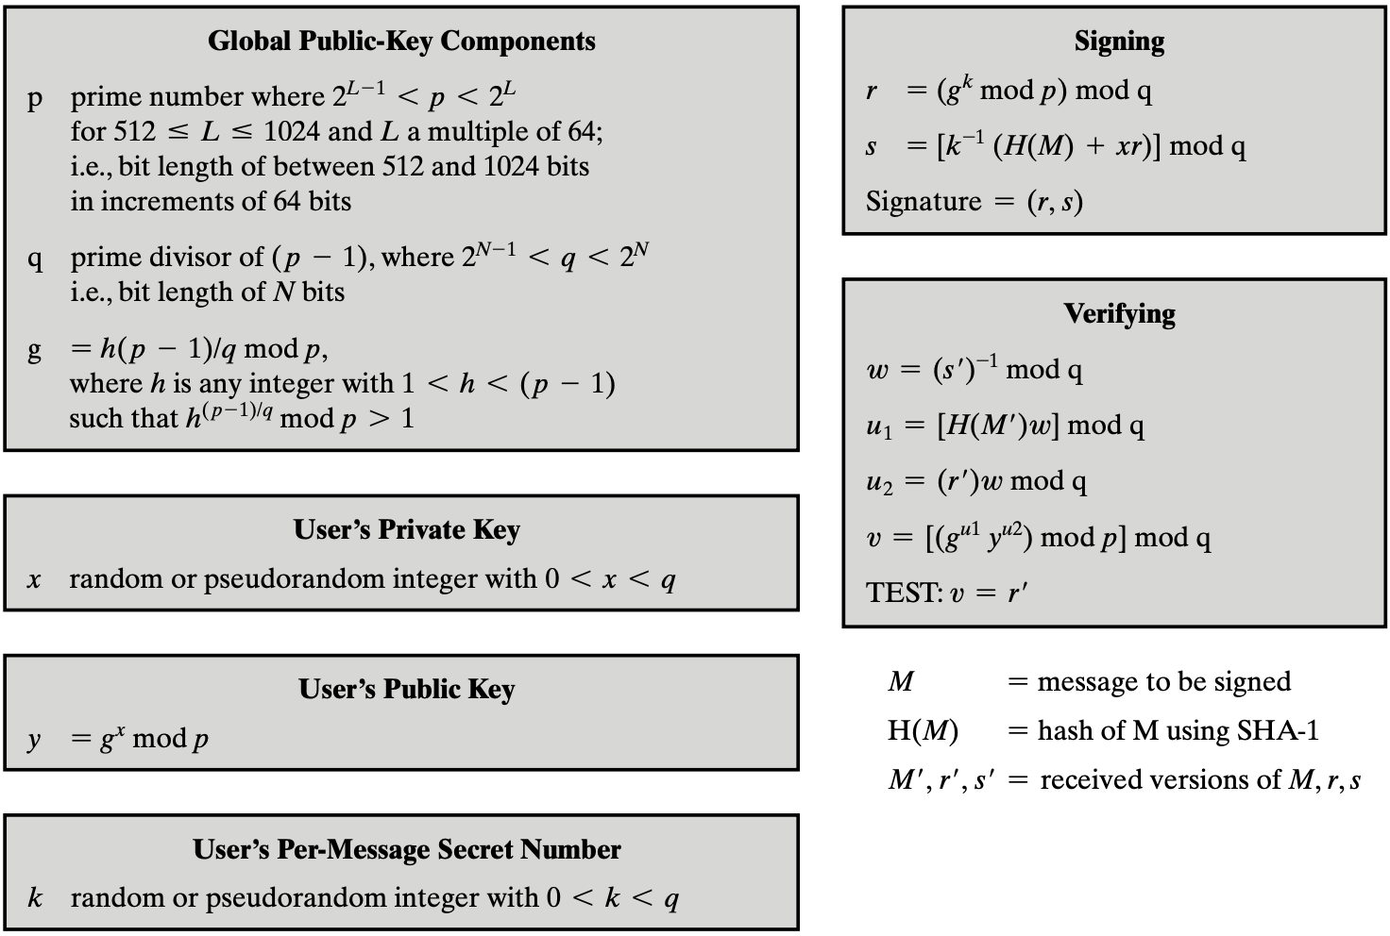
DSA Details #1

Slide 19
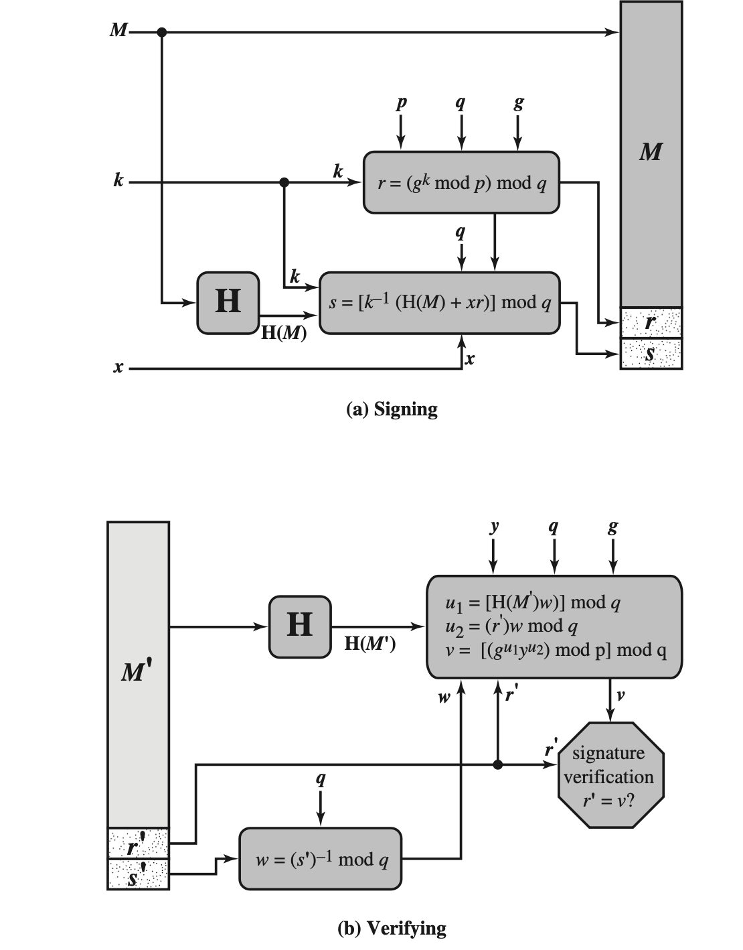
DSA Details #2

Slide 20
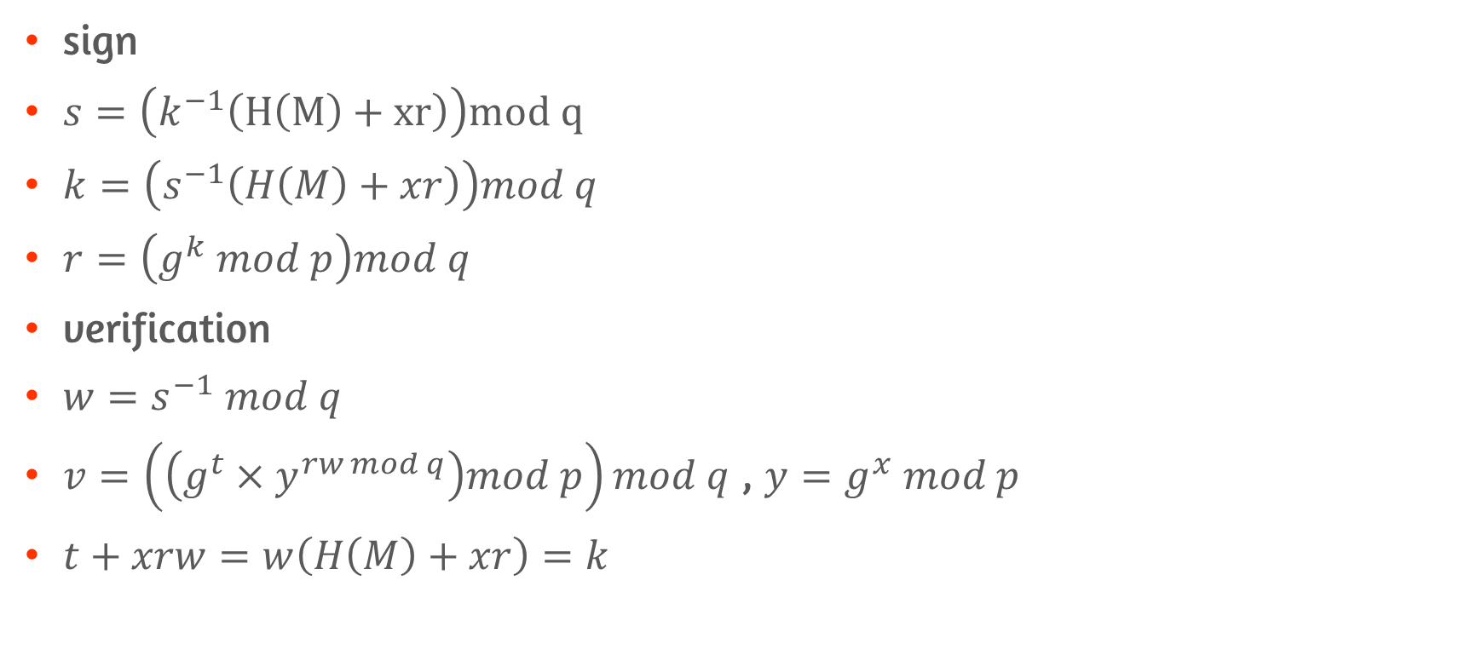
DSA Proof
sign
$s=\left(k^{−1}\left(H\left(M\right)+xr\right)\right)mod q$
$k=\left(s^{−1}\left(H\left(M\right)+xr\right)\right)mod q$
$r=\left(g^{k} mod p\right)mod q$
verification
$w=s^{−1} mod q$
$v=\left(\left(g^{t}×y^{rw mod q}\right)mod p\right)mod q$ , $y=g^{x} mod p$
$t+xrw=w\left(H\left(M\right)+xr\right)=k$

Slide 21
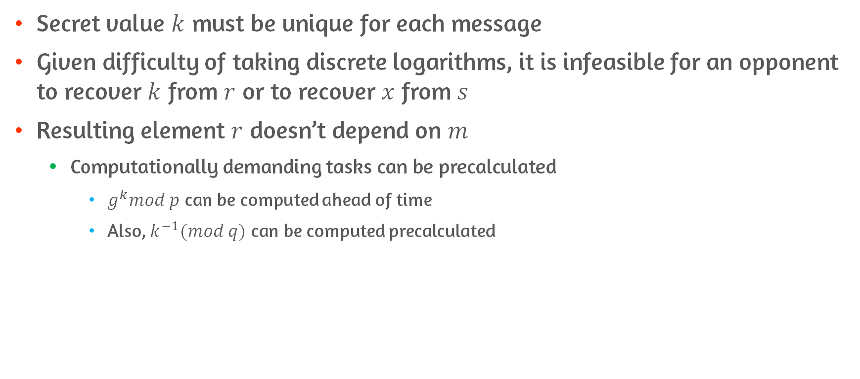
Characteristics of DSA
Secret value $k$ must be unique for each message
Given difficulty of taking discrete logarithms, it is infeasible for an opponent to recover $k$ from $r$ or to recover $x$ from $s$
Resulting element $r$ doesn’t depend on $m$
Computationally demanding tasks can be precalculated
$g^{k}mod p$ can be computed ahead of time
Also, $k^{−1}(mod q)$ can be computed precalculated

Slide 22
13.5 Elliptic Curve Digital Signature Algorithm(ECDSA)

Slide 23
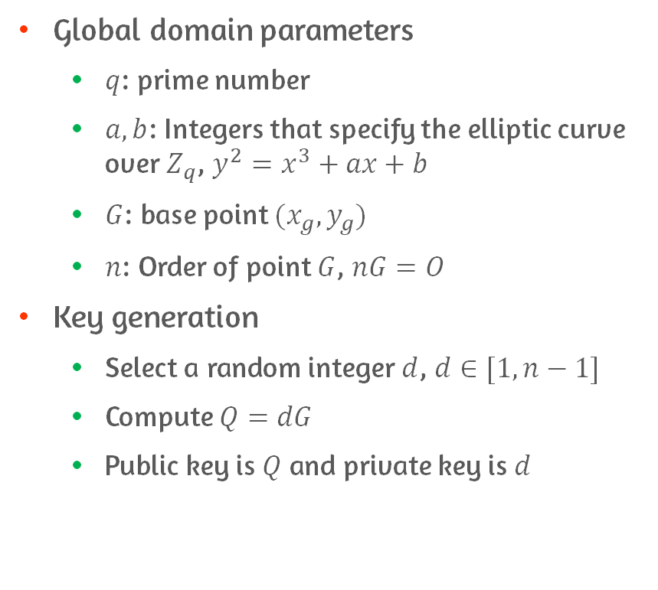
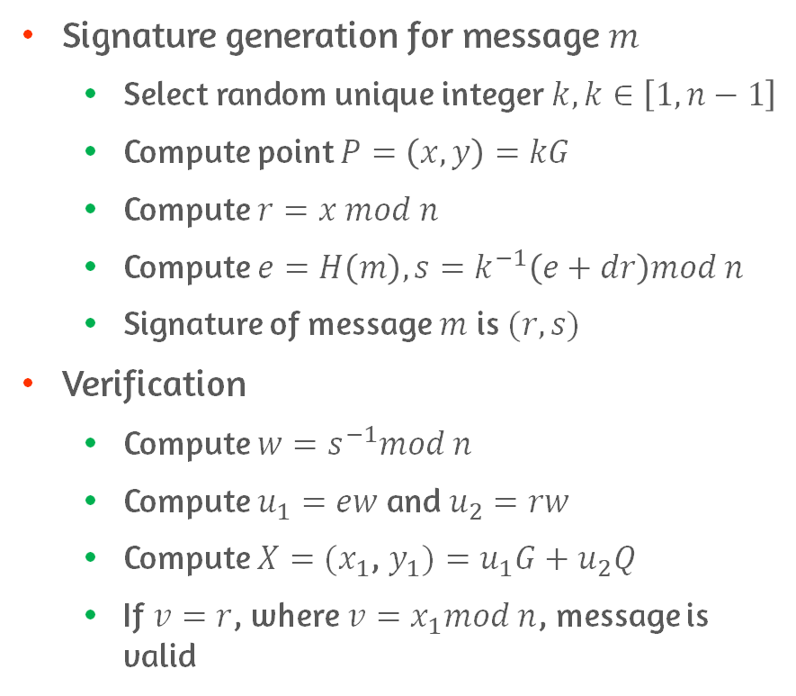
ECDSA
Global domain parameters
$q$: prime number
$a, b$: Integers that specify the elliptic curve over $Z_{q}$, $y^{2}=x^{3}+ax+b$
$G$: base point $(x_{g},y_{g})$
$n$: Order of point $G$, $nG=O$
Key generation
Select a random integer $d$, $d∈[1,n−1]$
Compute $Q=dG$
Public key is $Q$ and private key is $d$
Signature generation for message $m$
Select random unique integer $k, k∈\left[1,n−1\right]$
Compute point $P=\left(x,y\right)=kG$
Compute $r=x mod n$
Compute $e=H\left(m\right), s=k^{−1}\left(e+dr\right)mod n$
Signature of message $m$ is $(r,s)$
Verification
Compute $w=s^{−1}mod n$
Compute $u_{1}=ew$ and $u_{2}=rw$
Compute $X=(x_{1}$, $y_{1})=u_{1}G+u_{2}Q$
If $v=r$, where $v=x_{1}mod n$, message is valid

Slide 24
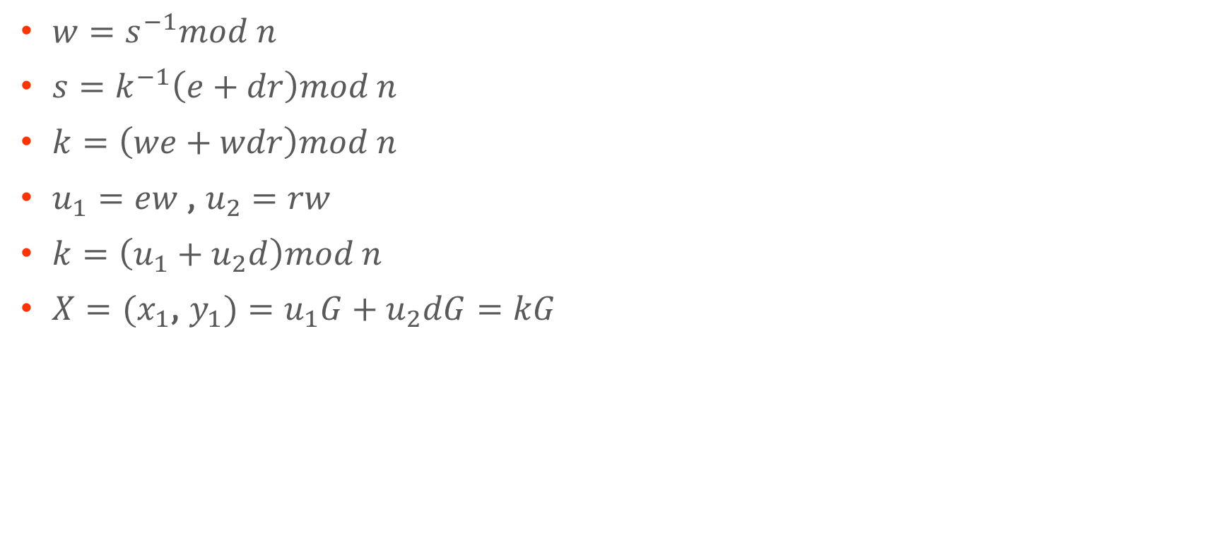
ECDSA Proof
$w=s^{−1}mod n$
$s=k^{−1}\left(e+dr\right)mod n$
$k=\left(we+wdr\right)mod n$
$u_{1}=ew$, $u_{2}=rw$
$k=\left(u_{1}+u_{2}d\right)mod n$
$X=(x_{1}$, $y_{1})=u_{1}G+u_{2}dG=kG$

Slide 25
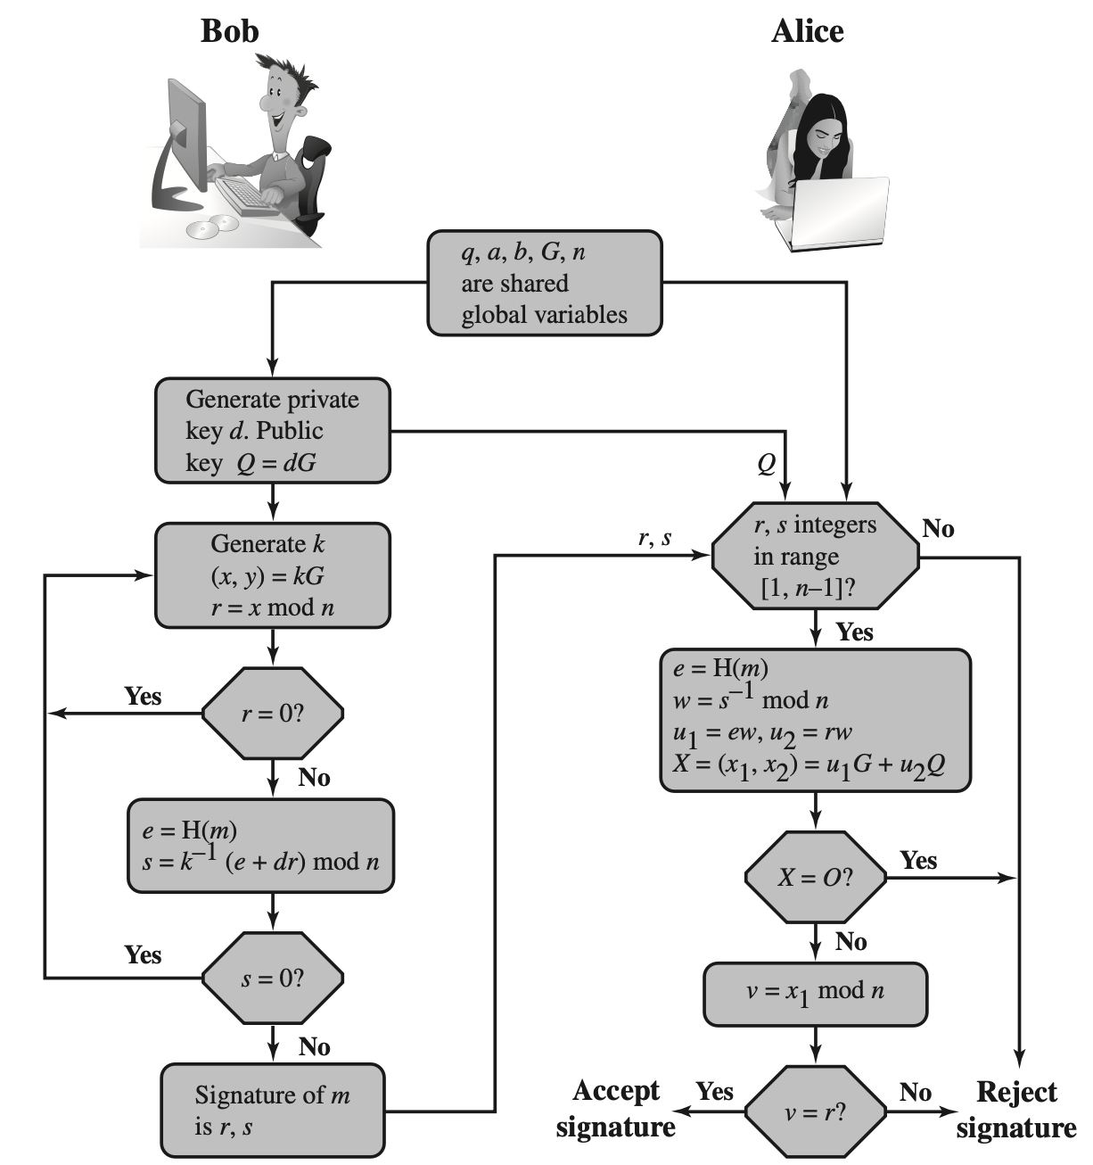
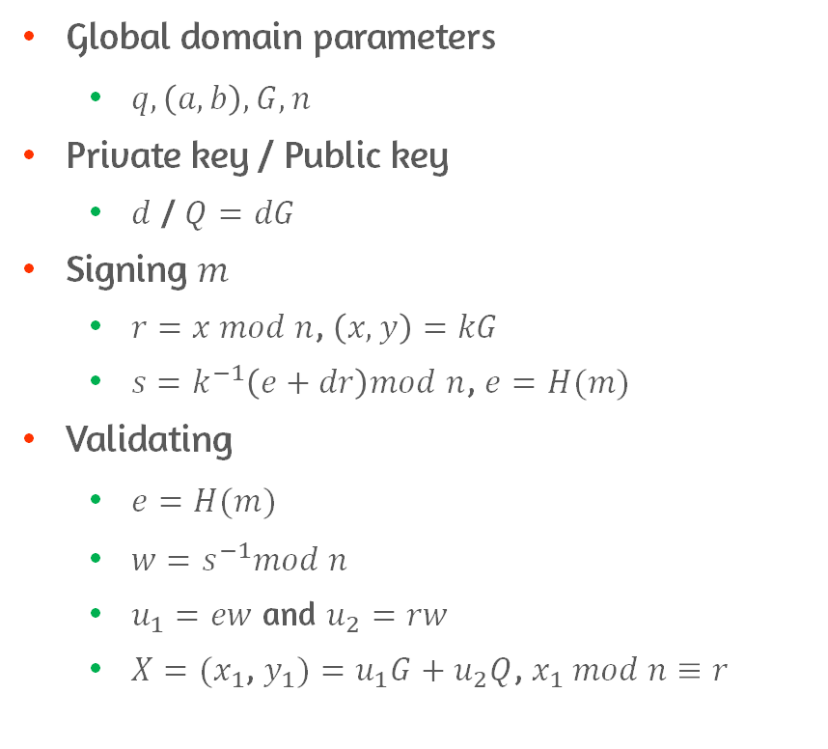
ECDSA Diagram
Global domain parameters
$q,\left(a,b\right),G,n$
Private key / Public key
$d$ / $Q=dG$
Signing $m$
$r=x mod n$, $\left(x,y\right)=kG$
$s=k^{−1}\left(e+dr\right)mod n$, $e=H(m)$
Validating
$e=H(m)$
$w=s^{−1}mod n$
$u_{1}=ew$ and $u_{2}=rw$
$X=(x_{1}$, $y_{1})=u_{1}G+u_{2}Q$, $x_{1} mod n≡r$

Slide 26
Conclusion
Present an overview of the digital signature process
Understand the Elgamal digital signature scheme
Understand the NIST digital signature scheme
Understand the elliptic curve digital signature scheme

